Slide 1
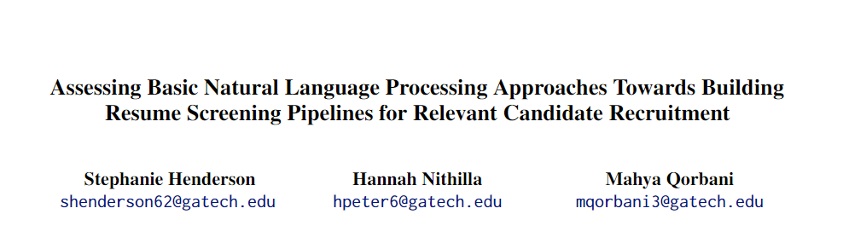
CS7650: Natural Language Final Project
Spring 2024

Slide 2
Goals: Mahya
Automated resume screening has become a standard practice in the recruitment process for a multitude of companies. However, are basic NLP techniques effective in pruning the possible resume choices, and recommending the top candidates for job opportunities? What are the ethical implications of the use of these automated systems?
We aim to simulate the following use case: when given a database containing several resumes classified to a specific profession, if given a job description, how successful is a simple NLP pipeline in finding the top candidates?

Slide 3
Existing approaches: Mahya
Research Paper | Year | Description
Automatic Process Resume in Talent Pool by Applying Natural Language Processing | 2021 | Simulates the same use case: a resume database stored by a recruitment system, which is evaluated to extract potential candidates for future job opportunities. However,in the approach by Quynh Trinh (2021), the researchers first extract relevant information from resumes, and then utilize a Word2Vec model to create embeddings to help for later candidate retrieval. In our approach, we examine different classification methods to first limit our evaluation of resumes to those belonging to a relevant profession, and then utilize a BERT model to create the embeddings for semantic search.
Resume classification system using natural language processing and machine learning techniques | 2022 | Examines possible resume classification approaches, including K-Nearest Neighbors and SVM. The experimenters of this approach were able to achieve 96% testing accuracy in classification. However, our team goes beyond just profession classification, and also supplies a recruiter with the top resumes.
Applying BERT-Based NLP for Automated Resume Screening and Candidate Ranking | 2024 | Utilizes a BERT model to establish embeddings of resumes and job descriptions, and utilize similarity metrics to retrieve the top candidates. Includes parsing resumes for skills. In our approach, we embed the entire resume and compare its similarity to an embedding of an entire job description/

Slide 4
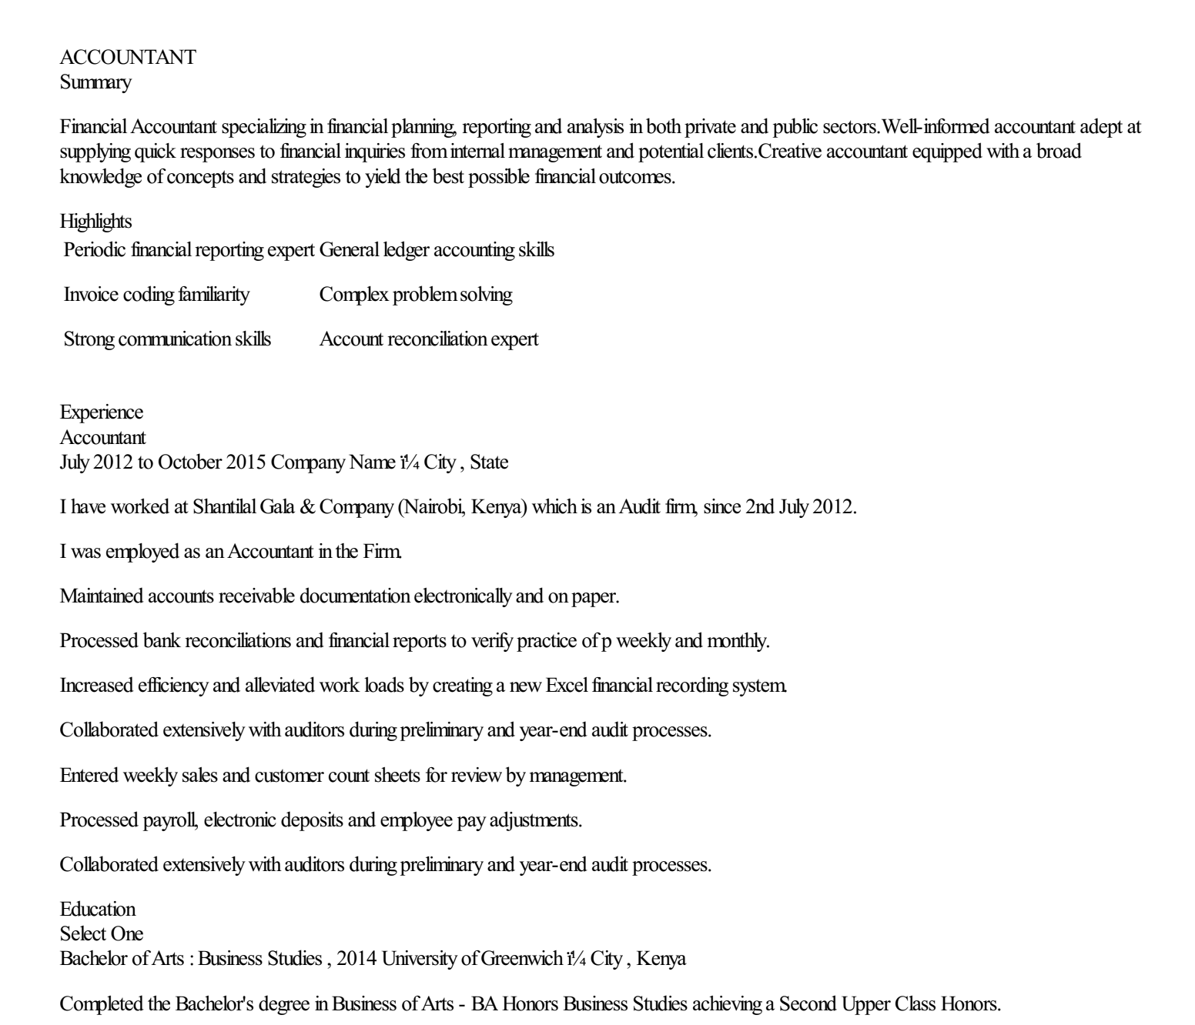
Data: Mahya
2400+ resumes, labeled to their corresponding profession.
Simulates a resume database stored by a company for later recruitment for open job opportunities (similar to Quynh Trinh’s 2021 research paper).
24 professions, such as accountant, chef, etc.
A limitation of this dataset is that the data is not balanced amongst the labels. For example, the "automobile" profession only has 36 resumes, while the "accountant" profession has 116 resumes.
Additionally, we ran a python script to generate embeddings of each resume utilizing a BERT Embedding Model.
Figure: Example resume within the dataset

Slide 5
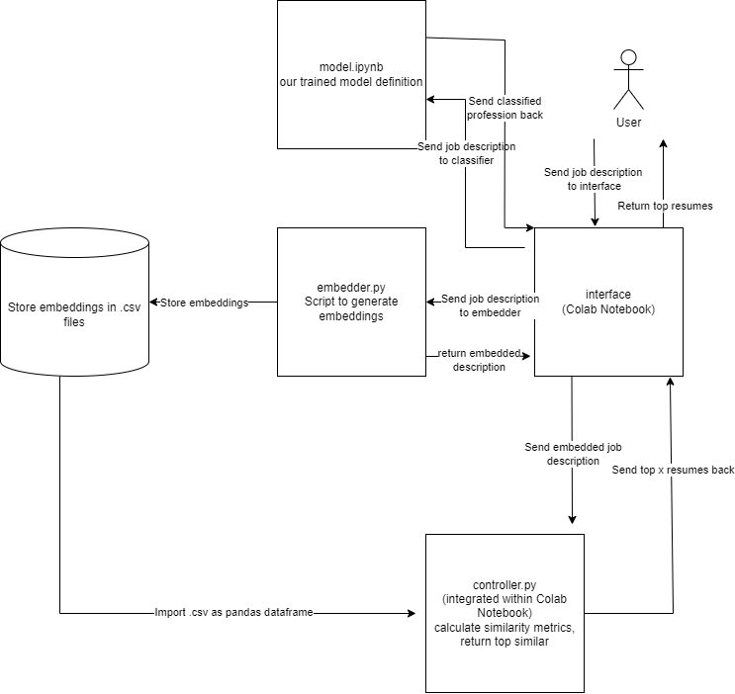
Methodology: Stephanie
Embed resumes from Kaggle Dataset
Prune possible professions for a given job description using best classifier
Limits which resumes we need to evaluate
Import relevant resume embeddings only belonging to classified profession
Return top resumes through the use of the most relevant similarity metric
Notes:
Now I will go over our simple pipeline which splits the process of resume generation into two phases.
The first phase aims to prune the possible resume candidates by first classifying a given job description to its most relevant job profession.
The second phase aims to use an embedding model to embed the job description and compare it to the saved embeddings of the resumes, and utilize similarity metrics to retrieve the top 5 results.

Slide 6
BERT Model for Profession Classification: Stephanie
Our team employed the approach of training a BERT (Bidiectional Encoder Representations from Transformers) Model. Our team hypothesized that this NLP approach would work best, due to BERT models ability to leverage context from surrounding words within the resume to create meaningful embeddings, allowing for successful tests of semantic similarity between embeddings, as entailed in Hashemi-Pour and Lutkevich (2024).
We trained the BERT model for 10 epochs, and it was able to obtain 80.72% testing accuracy, the highest of the three tested approaches. We utilized the AdamW optimizer, an alternate form of the Adam optimizer which decouples weight decay, as explored in Loshchilov and Hutter (2019). We utilized a learning rate of 0.00005 to achieve this accuracy
from transformers import BertForSequenceClassification, AdamW
model = BertForSequenceClassification.from_pretrained('bert-base-uncased’)

Slide 7
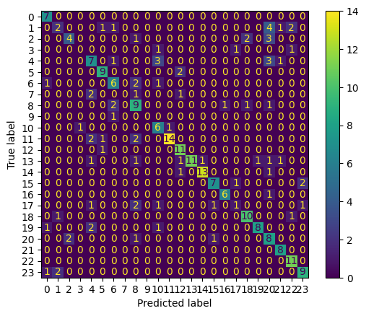
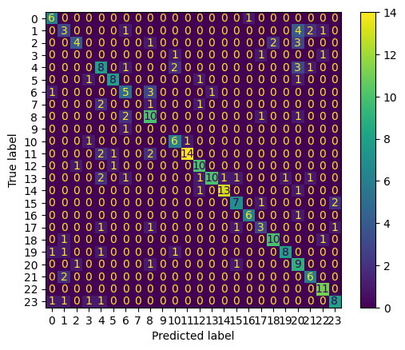
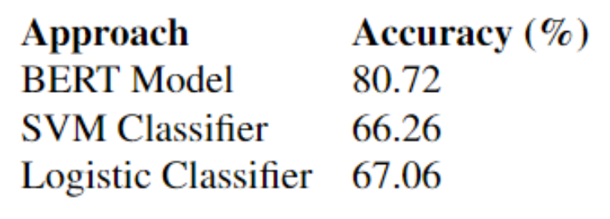
Baseline Linear Classifier Approach for Profession Classification: Hannah
Testing Accuracy Comparison Between Models for Profession Classification
Logistic Classifier Confusion Matrix
SVM Classifier Confusion Matrix

Slide 8
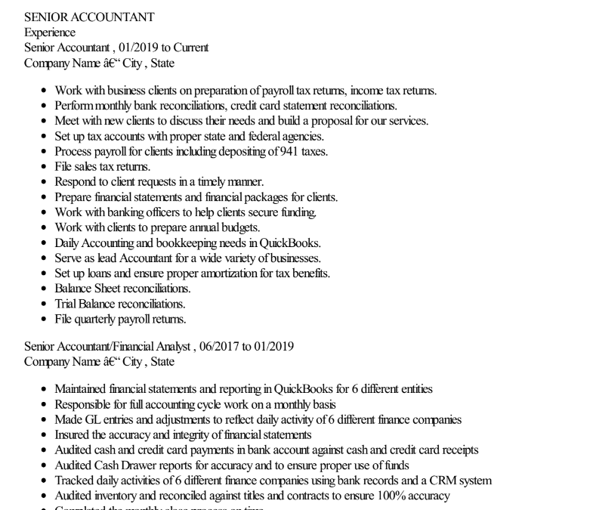
Cosine Similarity for Resume Retrieval: Stephanie
Our team hypothesized that the use of cosine similarity would yield the most relevant resumes.
Example tested job description:
We are looking for an Entry Level Tax Accountant to join our team in Metro Atlanta! We are looking for someone who is self-motivated and able to work in a fast-paced environment. All qualified individuals are encouraged to apply
RESPONSIBILITIES -
Work with business clients on preparation of payroll tax returns, income tax returns.
Perform monthly bank reconciliations,credit card statement reconciliations.
Meet with new clients to discuss their needs and build a proposal for our services.
Set up tax accounts with proper state and federal agencies.
Process payroll for clients including depositing of 941 taxes.
SKILLS -
• Bachelor's Degree Required, in Accounting/Finance or related degree
• 6 Months + of related experience (internships will be considered)
• Strong interpersonal skills. Candidate must have the ability to work in teams and help promote a team environment as well as professionally manage client relationships
• Ability to use Microsoft Offices, Outlook, and various accounting applications
Top result:

Slide 9
Other Similarity Metrics for Relevant Resume Retrieval: Hannah
We found that, even when including skills on a test job description found verbatim within resumes of our existing dataset, the Jaccard Distance metric was not effective in yielding the desired resume. The jaccard distance metric evaluates similarity between vectors by looking at their intersection opposed to their union (Yassine El Khal, 2023)
We found that Euclidean Distance was nearly as effective in our human inspection of the returned resumes. Often, the euclidean distance metric would yield the same top candidate, and even the same top 3-4 candidates as the cosine similarity metric. With this result, it may be helpful to include several similarity metrics (cosine similarity and euclidean distance) in the retrieval of candidate resumes in the automated screening process for job opportunities, in order to help reinforce relevant candidate retrieval
Notes:
https://yassineelkhal.medium.com/the-complete-guide-to-string-similarity-algorithms-1290ad07c6b7#:~:text=Jaccard%20distance%20is%20a%20measure,unique%20elements)%20of%20the%20sets.

Slide 10
Future Enhancements and Limitations: Stephanie
Future Enhancements
top_schools: {‘MIT’, ‘Carnegie Mellon’, …, }
top_companies: {‘Google’, ‘Amazon’, …}
As with any automated screening of a candidate, we anticipated a multitude of limitations with our approach.
Our approach only highlights the semantic similarity between a job description and a resume.
While our model may be able to find relevant candidates due to returning resumes with skills that are very similar to skills listed on the job description, our model will fail to capture important information regarding unique qualifications of individuals.
model.py

